Slide 1

Crop Prediction using Machine Learning
Preet Kumar(2K21/SE/143)
Saurabh Kumar(2K21/MC/152)

Slide 2

Contents
Introduction to Crop Prediction
Dataset and Algorithm
Exploratory Data Analysis
Handling Outliers in Data
Correlation and Feature Analysis
Data Preprocessing and Feature Scaling
Model Training and Evaluation
Impact and Future Directions
Conclusion and Recommendations
Challenges and Opportunities
Future Research and Development
Thank You
Results

Slide 3
Introduction to Crop Prediction
In this presentation, we will explore the use of machine learning for crop prediction. We'll discuss how the algorithm takes into account soil nutrients, pH value, rainfall, and humidity to predict the best crops to grow in a particular area, ultimately increasing yield in farming and agriculture.

Slide 4

Dataset and Algorithm
Crop Analysis and Prediction
Machine Learning Dataset
The dataset includes information on soil nutrients such as Nitrogen, Phosphorus, and Potassium, along with pH value, average rainfall, and humidity. The model uses Logistic Regression, Random Forest, and Decision Tree Algorithm for prediction.
Model Predictions
The model predicts the best crop to grow in a particular area based on the soil information, helping farmers overcome yield loss due to lack of knowledge.
Sample Soil Testing
Once the soil is tested and nutrient levels are known, the model is ready to make accurate crop predictions.

Slide 5

Exploratory Data Analysis
Understanding Crop Data
1 Data Overview
The dataset consists of 2200 entries with information on soil nutrients, temperature, humidity, pH, and rainfall for various crops.
2 Data Distribution
Visualizations such as histograms and pie charts help in understanding the distribution and frequency of different crop labels.

Slide 6

Handling Outliers in Data
To ensure accurate predictions, outliers in the data are removed using the Interquartile Range (IQR) method. By identifying and handling outliers, the model becomes more robust and reliable in its predictions.

Slide 7

Correlation and Feature Analysis
Understanding Data Relationships
1 Correlation Heatmap
A heatmap is used to understand the correlation between different features in the dataset, helping in feature selection for the model.
2 Feature Influence on Crop
Bar plots show the influence of soil nutrients, humidity, and temperature on different crop types, aiding in understanding which features are significant for prediction.

Slide 8

Data Preprocessing and Feature Scaling
Preparing Data for Model Training
1 Splitting Data
The data is split into training and testing sets to prepare for model training and evaluation.
Feature Scaling
StandardScaler is used to scale the features, ensuring that all variables contribute equally to the model's predictions.
Variance Inflation Factor (VIF)
VIF analysis is performed to check for multicollinearity among the features, ensuring the independence of predictors in the model.

Slide 9
Model Training and Evaluation
Building and Assessing Model Performance
Logistic Regression
The logistic regression model shows high precision, recall, and F1-score, indicating accurate crop predictions.
Decision Tree Algorithm
The decision tree model also demonstrates excellent precision, recall, and F1-score, ensuring reliable crop prediction.
Random Forest Classifier
The random forest classifier exhibits superior accuracy, precision, recall, and F1-score, making it a robust model for crop prediction.

Slide 10
Impact and Future Directions
The success of the machine learning model in crop prediction has the potential to significantly impact the agricultural sector, helping farmers make informed decisions to improve yield. Future work involves expanding the dataset and refining the model for more accurate predictions.

Slide 11
Conclusion and Recommendations
Key Takeaways and Suggestions
Key Findings
The presentation highlighted the significance of machine learning in crop prediction and its potential to revolutionize agriculture.
Recommendations
It is recommended to integrate the developed model into farming practices to help farmers make informed decisions for increasing crop yield.

Slide 12
Challenges and Opportunities
Overcoming Obstacles and Leveraging Advantages
1 Challenges Faced
The presentation also discussed the challenges faced in agriculture and how machine learning can address these issues.
2 Opportunities Ahead
By leveraging machine learning for crop prediction, there are numerous opportunities for improving agricultural practices and increasing productivity.

Slide 13
Future Research and Development
Future research should focus on enhancing the predictive capabilities of the model, exploring additional features that impact crop yield, and collaborating with agricultural experts for
real-world implementation.

Slide 14
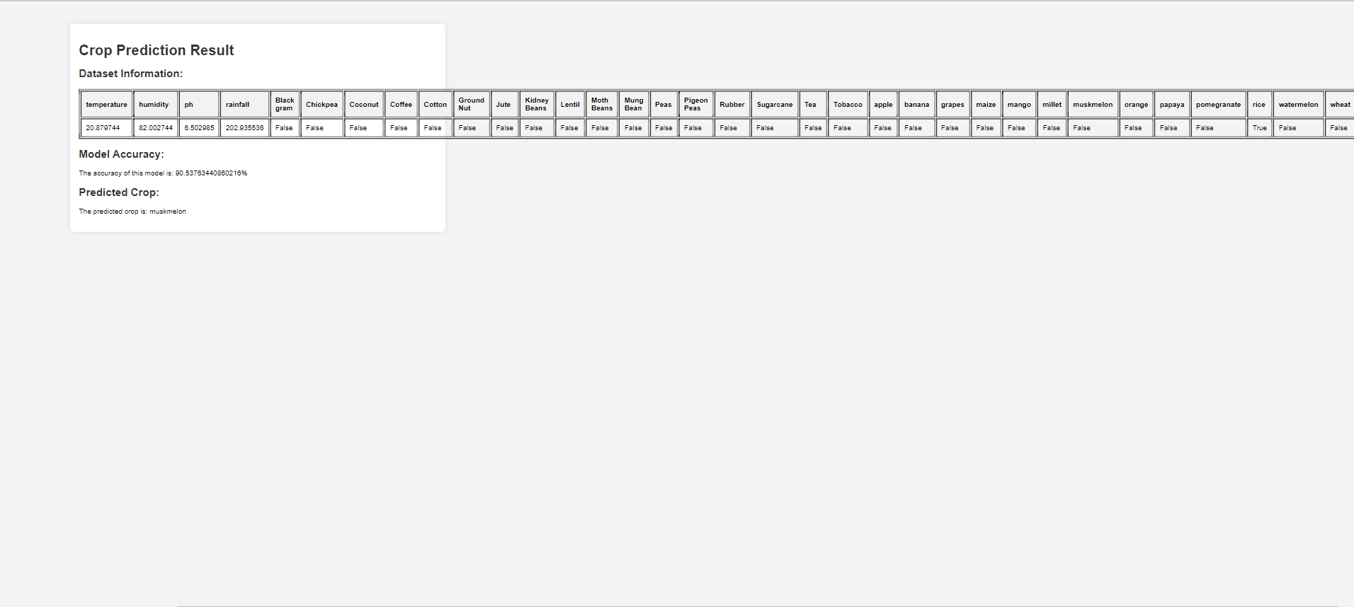
Result

Slide 15
Thank You

